Slide 1
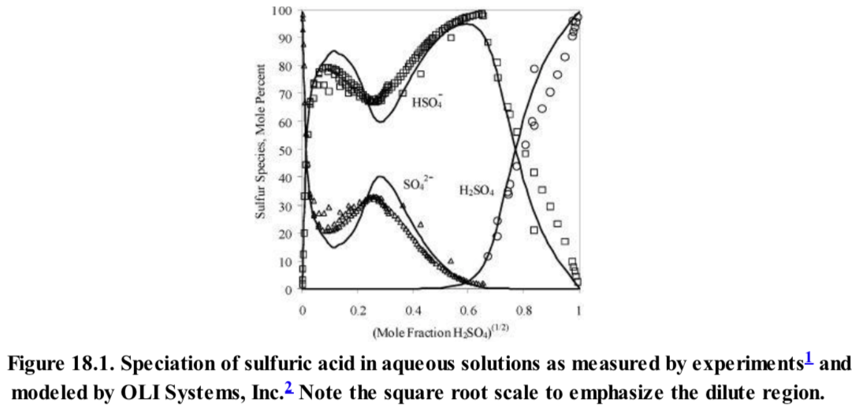
Chapter 18 Electrolytes
Strong Electrolyte NaCl in water (strong dielectric, ions completely formed)
Weak Electrolyte Acetic Acid in water (use dissociation constant)

Slide 2
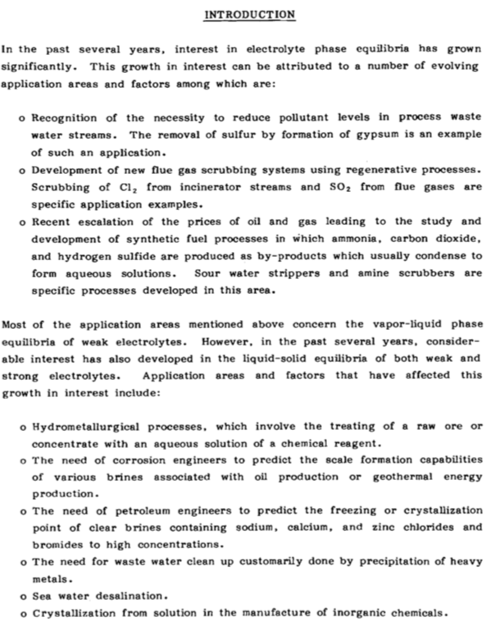
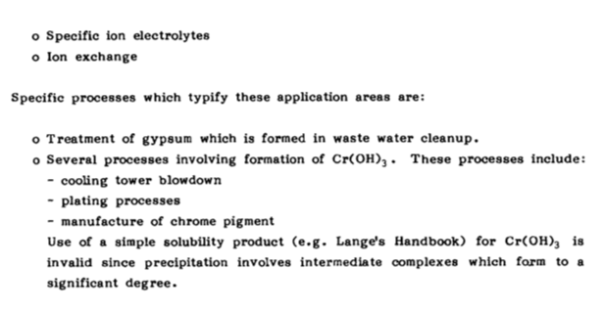
Chapter 18 Electrolytes
Handbook of Aqueous Electrolyte Thermodynamics

Slide 3
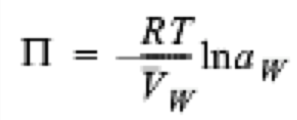
Colligative (counting) Properties
Melting Point Depression
Osmotic Pressure Π/RT = (c/M_{w}) (1 + B₂ c + …)
y_{H2O} P = P = x_{H2O}P_{H20}^{Sat}
Boiling Point Elevation (for non-volatile solute)

Slide 4
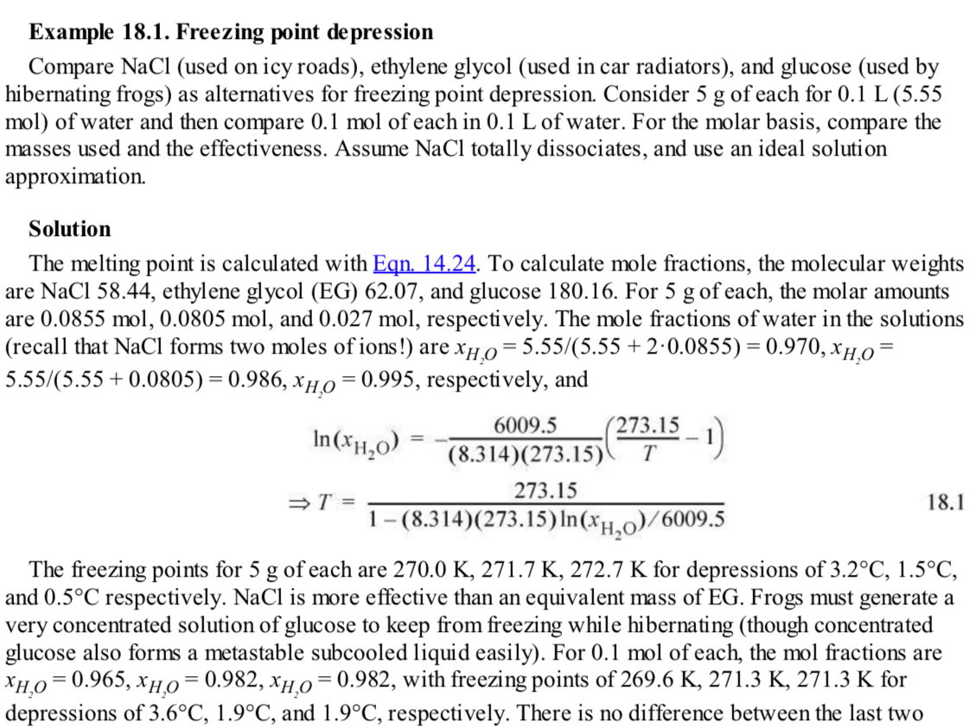

Slide 5
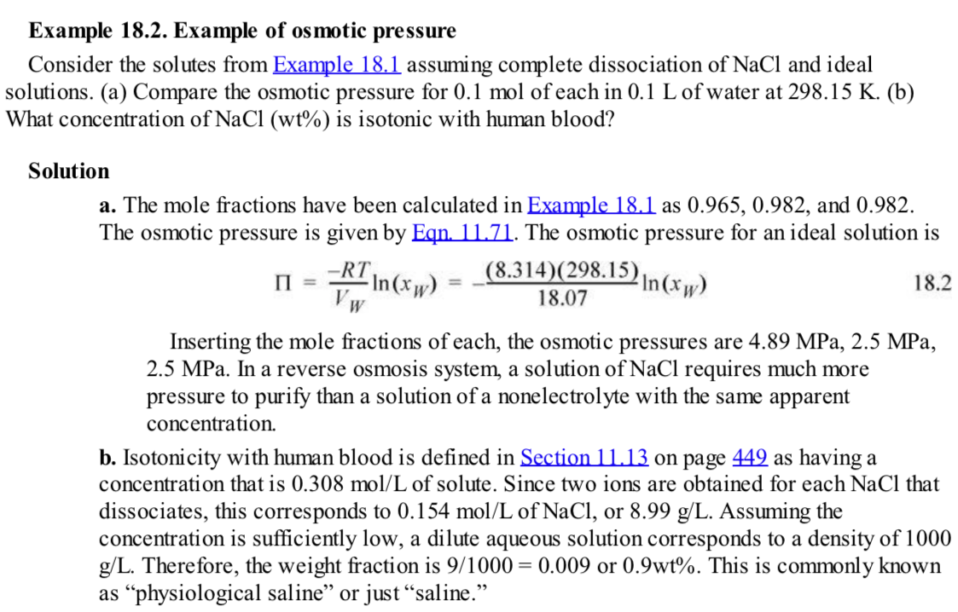

Slide 7
Speciation and dissociation constant K_{a,298}, charge balance
a_{H+} is dimensionless, [H⁺] is moles/liter (molarity, M_{H+})
A neutral solution is pure water so a_{H2O} = 1
With temperature changes [H⁺] changes due to thermal expansion
Molality, number of moles of H⁺ per kg of H₂O is used, m_{H+}

Slide 9
Concentration with speciation
Acetic Acid in water
Apparent concentration: g/liter you put in of C₂H₄O₂
True concentration has to do with the dissociation species (based on a model)
VLE is based on the true concentration of undissociated species

Slide 10
pH
pH = -log₁₀(a_{H+})
a_{H+} is molal (molar as an approximation)

Slide 11
Electrolyte Equilibrium Constant
Succinic Acid

Slide 12
Water of hydration and hydronium ion
Cations have water of hydration associated with the ion
Degree of hydration changes with concentration
At high concentrations ion pairs with the counter ion form

Slide 13
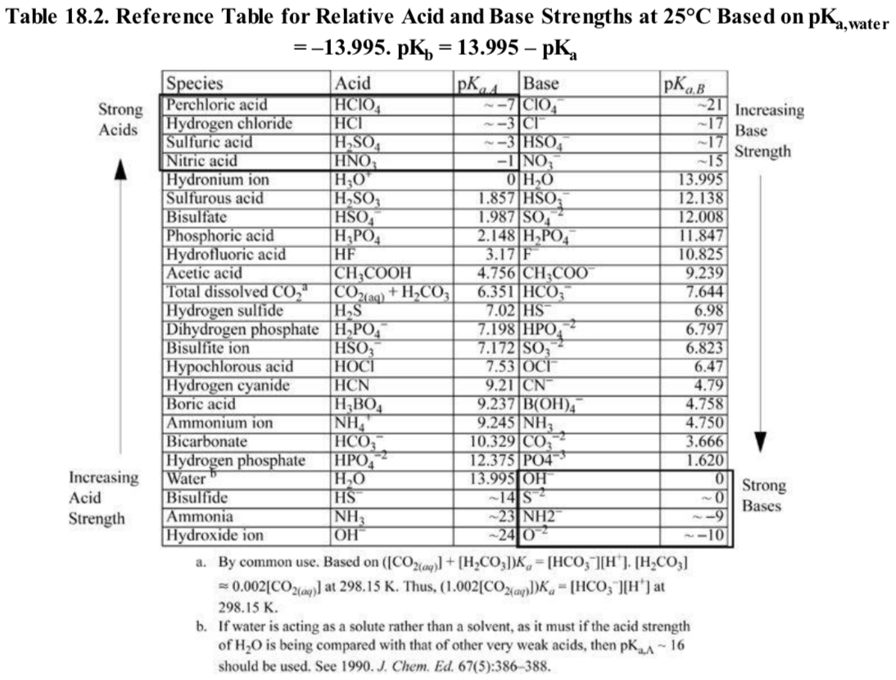
Acids and conjugate bases

Slide 14
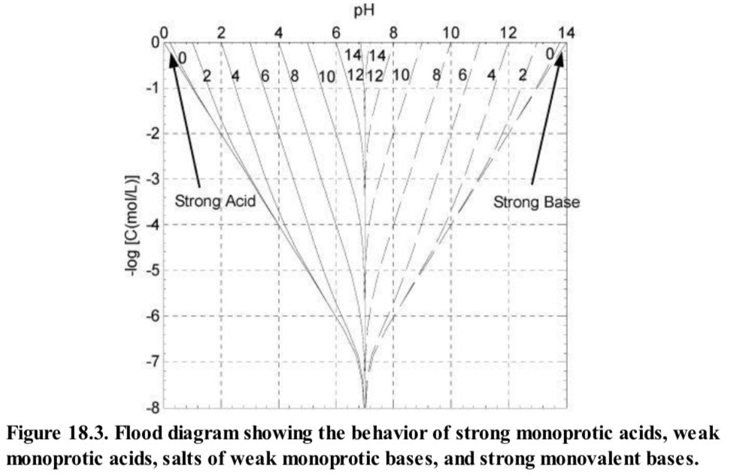
Strong Acid
[H⁺] is large so [OH⁻] is very small, can be ignored
pH ~ pC_{A}

Slide 15
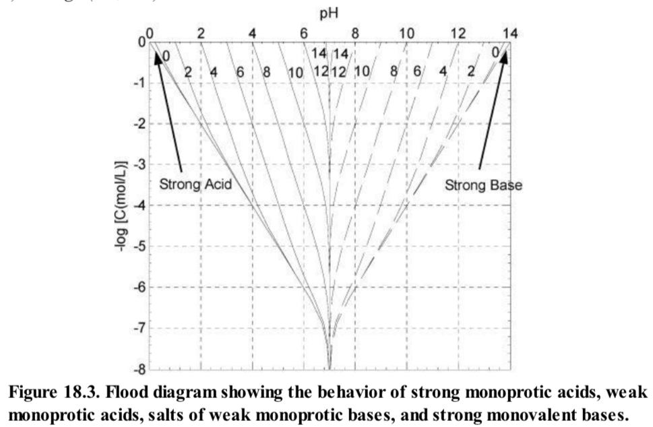
Strong Base
[OH⁻] is large so [H⁺] is very small, can be ignored
pOH ~ pC_{B}

Slide 16
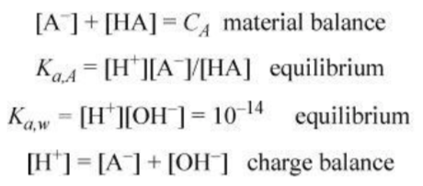
Weak monoprotic Acid (Acetic Acid pK_{a,A} = 4.7)

Slide 17
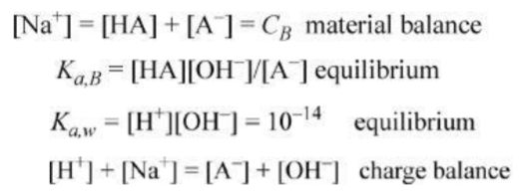
Weak monoprotic Based (Acetate ion pK_{a,B} = 9.3)
Start with sodium acetate which is a strong electrolyte, the resulting acetate ion is a weak base

Slide 18
Acid or Base Added to water

Slide 19
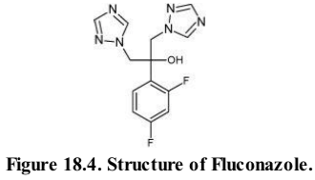
Base
Acid
Standard acid form of eqn. 18.39
At 298K, K_{a,B} = 6.18 e-13 from eqn. 18.39
K_{a,A} = 1e-14/6.18 e-13 = 0.0162 or pK_{a,A} = 1.79
Fluconazole is protonated below pH = 1.8 and neutral (undissociated) above
pH = 7
None is dissociated so:

Slide 20
Base
Acid
Standard acid form of eqn. 18.39
At 298K, K_{a,B} = 6.18 e-13 from eqn. 18.39
K_{a,A} = 1e-14/6.18 e-13 = 0.0162 or pK_{a,A} = 1.79
Fluconazole is protonated below pH = 1.8 and neutral (undissociated) above
pH = 1.5
About half is dissociated:

Slide 21
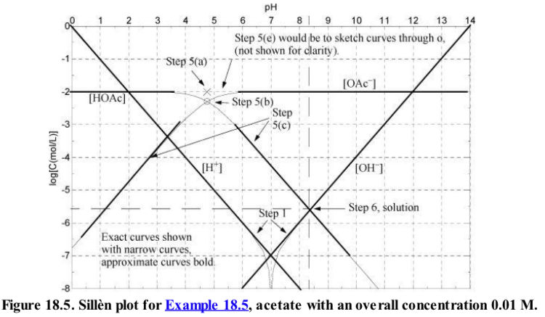
Sillén Diagram or Bjerrum Plot or Hägg Diagram

Slide 22
Sillén Diagram

Slide 23
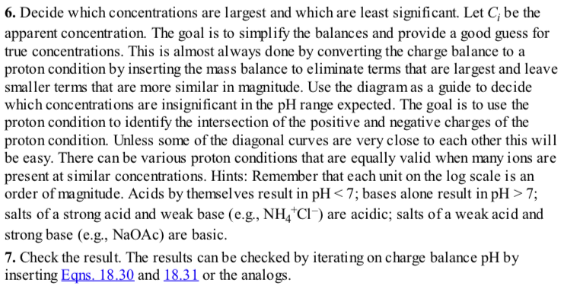

Slide 24
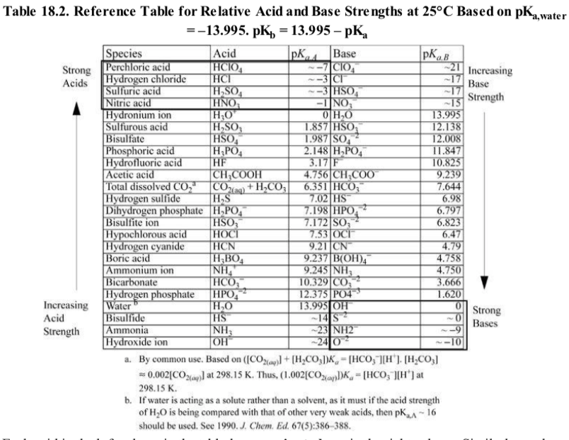

Slide 25
[OH⁻][H⁺]=10⁻¹⁴ so log [OH⁻]+log[H⁺] = 14 (two lines as drawn)
When one component is small the other is C_{B}
When [OAc⁻] = [HOAc] then K_{a,A} = [H⁺]
When [OAc⁻] = [Na⁺] then [OH⁻] = [HOAc] this gives the pH
[HOAc] is parallel to [H⁺] when [H⁺] is small
[H⁺]=10⁻¹⁴/[OH⁻] so [OAc⁻] is parallel to [OH⁻] when [OH⁻] is small

Slide 26
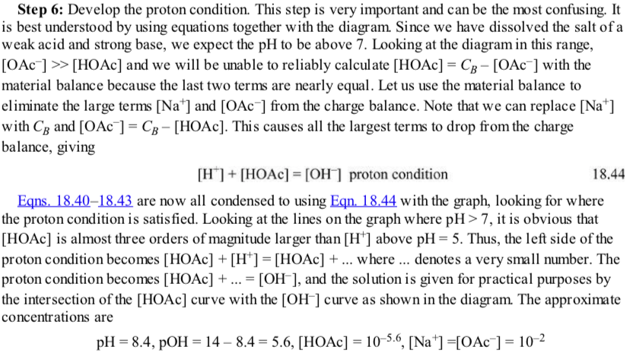

Slide 28
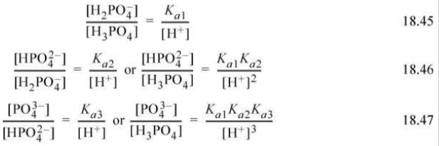

Slide 31
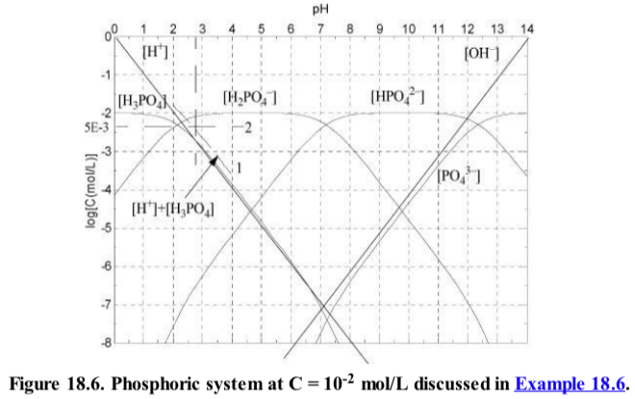

Slide 32
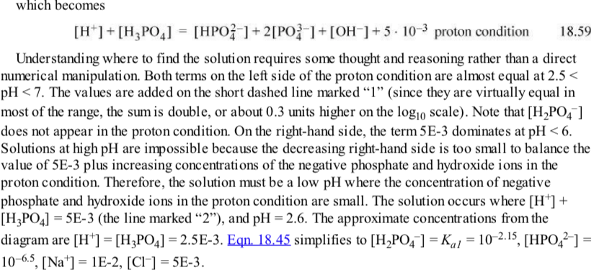

Slide 34
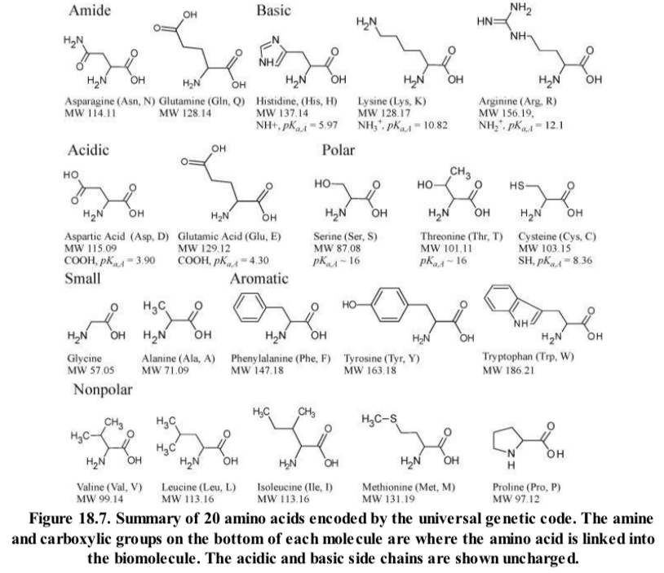
Amino Acids (Zwiterions)

Slide 35
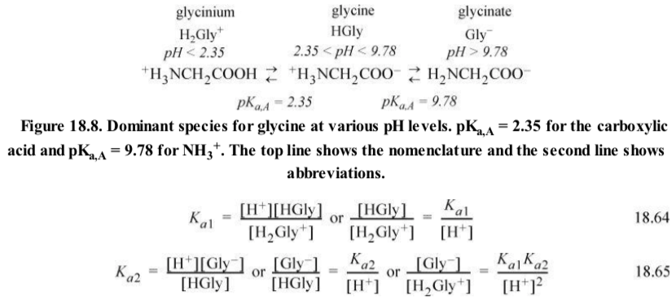
Amino Acids (Zwiterions)

Slide 36
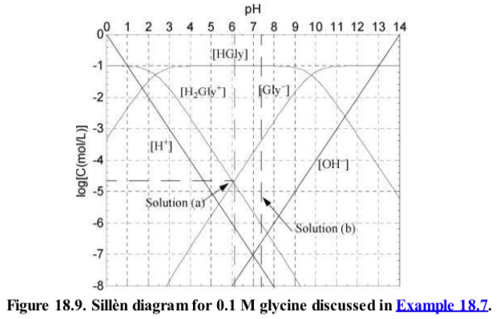

Slide 37
Charge balance (18.67) is reached about where 1.1[H₂Gly⁺] = [Gly⁻], a little above pH = 6

Slide 38
Buffer: a salt and an acid that share a common ion
Acetic Acid and Sodium Acetate
Henderson-Hasselbalch Equation

Slide 39
Buffer: a salt and an acid that share a common ion
Acetic Acid and Sodium Acetate
Better equation:

Slide 40
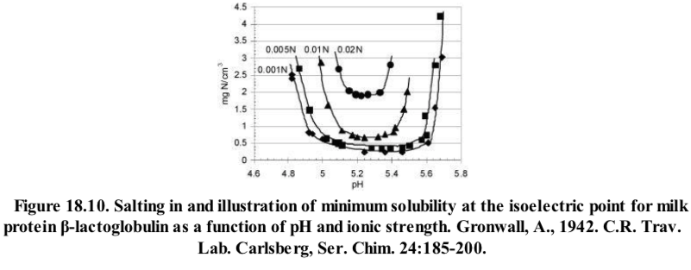
Isoelectric Point
For a zwitterion like an amino acid amines protonate at neutral pH and carboxylic acids are deprotonated. When there is no net charge the pH = pI is the isoelectric point. Solubility is at a minimum at the isoelectric point.

Slide 41
Ionic Strength (salt concentration)
For low ionic strength, as ionic strength increases, solubility increases (salting in).
For high ionic strength, as ionic strength increases, solubility decreases (salting out).
Maximum solubility at intermediate salt concentrations.
Salting in

Slide 42
Donnan Equilibria

Slide 43
Solubility
Solubility and vapor pressure rely on equilibria with the un-ionized species. So solubility depends on pH. Remember, the activity of a solid is 1.
K_{SLE} = 0.0180 at 298K; pH 1.5 [H⁺] = 0.0316; pH 7 [H⁺] = 1e-7; K_{a} = 6.18 e-13; pK_{a} = 1.8 so protonated below pH 1.8 and undissociated above pH 7
From slide 18 example 18.4

Slide 44
Common ion effect
Add NaCl to a KCl saturated solution causes precipitation

Slide 45
Redox Reactions OILRIG
Lose or gain electrons
Electrochemical Cell (discharge)
Anode:
Cathode:
3.9 Volts
Oxidation (OIL)
Reduction (RIG)
Reference voltage is platinum electrode:H₂(g) electrode at pH = 0; 298K; 1 bar
Reduction of H⁺ Potential set to 0 as reference

Slide 46
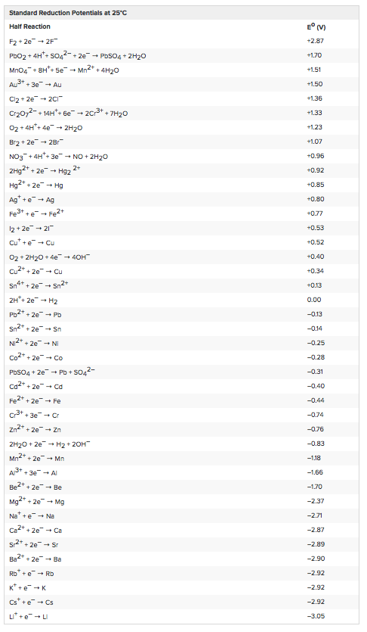

Slide 47
Redox Reactions OILRIG

Slide 48
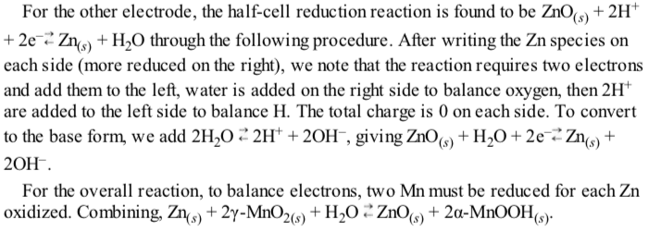

Slide 49
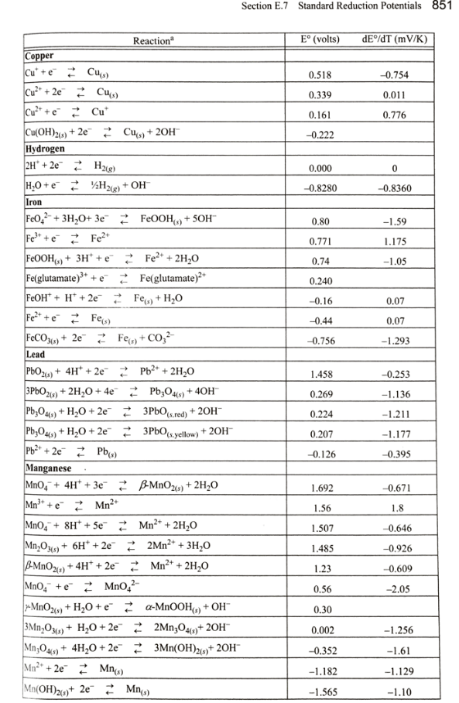
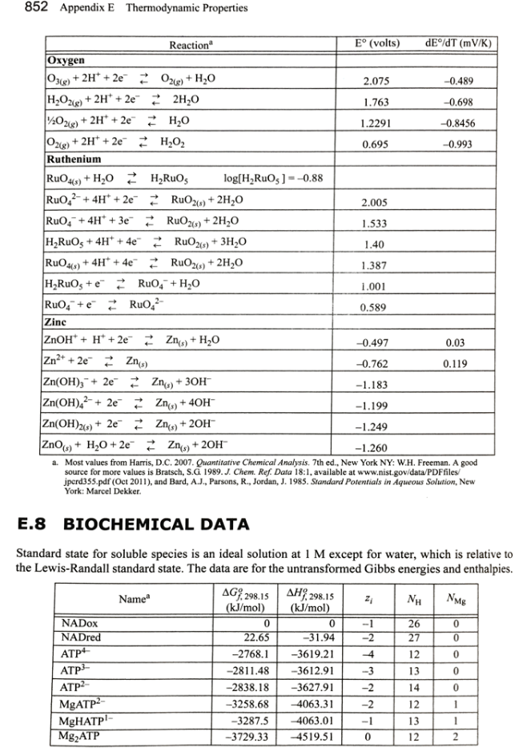

Slide 51
Bioprocess Engineering (Fermentation)
Degree of Reduction
Stoichiometry
Oxidation State
O2 is 0; in products is -2
Moles of electrons transferred to oxygen
The degree of reduction multipliers are +4 for C; +1 for H; -2 for O; -3 for N (ammonia); +6 for S (H₂SO₄); +5 for P (phosphoric acid)
Reaction of acetaldehyde C₂H₄O Degree of reduction 2(4)+4(1)+1(-2)=10 or 5 per carbon.
To determine r for O₂, 2r(-2) = -10 so r = -2.5 to yield zero on the left of 18.88
On the right of 18.88, For CO₂, 1(4)+2(-2) = 0 and for H₂O, 2(1)+1(-2) = 0
Two sides balance

Slide 52
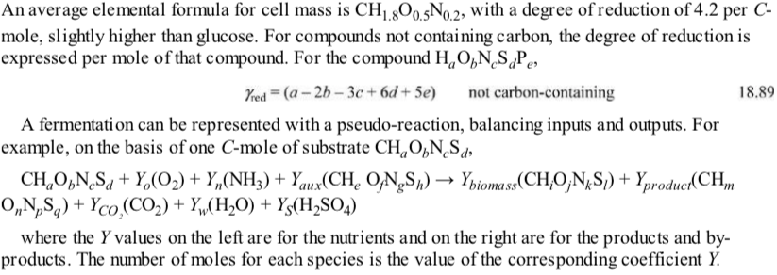

Slide 53
Biological Equilibrium Reactions
Reactions occur with a buffer so [H⁺] is ignored (indicated by prime)
Water is pure so activity is 1

Slide 54
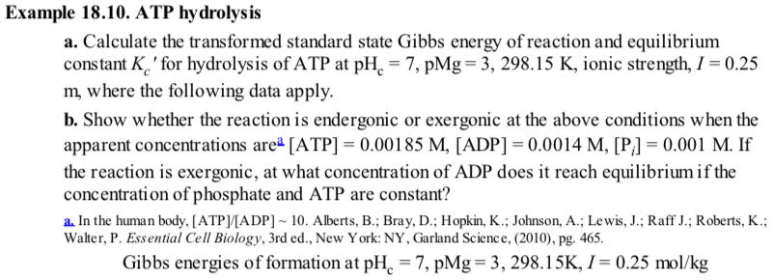

Slide 55
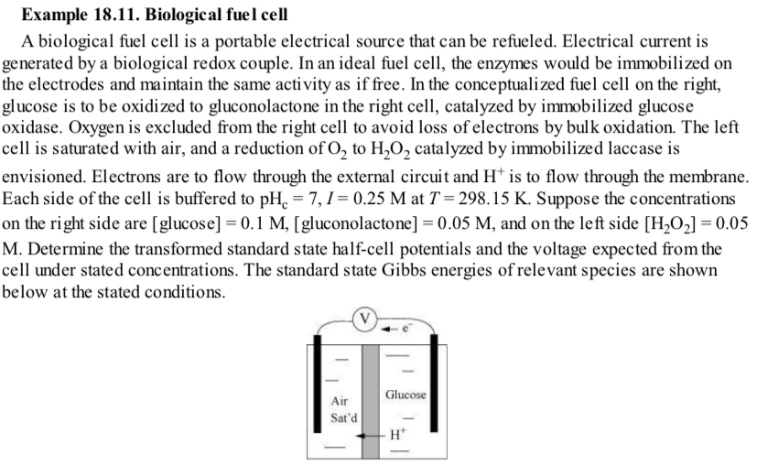

Slide 56
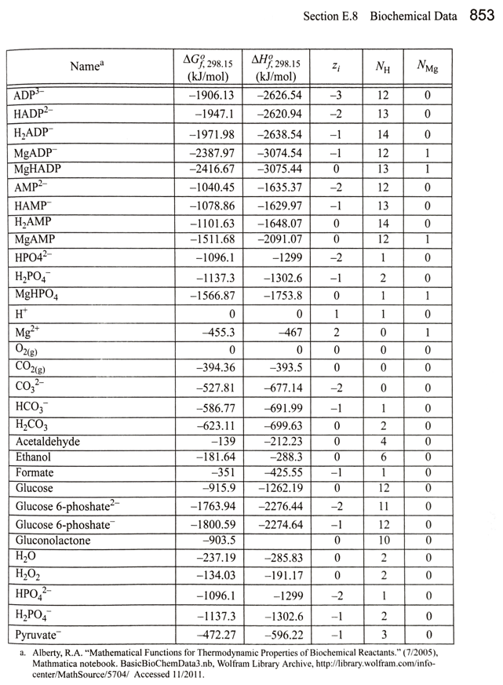

Slide 58
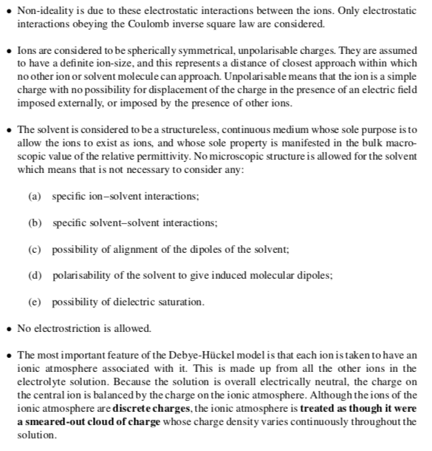
Debye-Hückel Model
Mean field

Slide 59
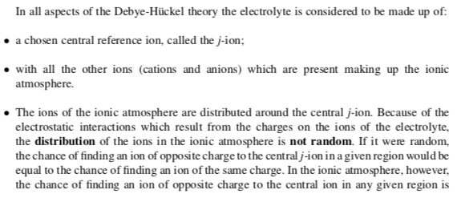
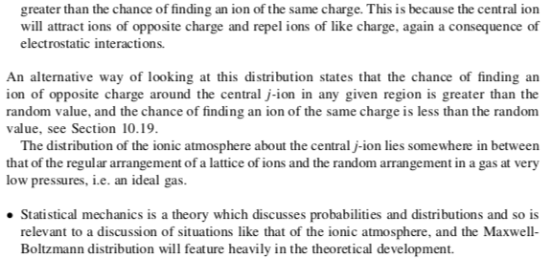
Debye-Hückel Model
Coulomb’s Law
Work to place an ion in a solution of other ions

Slide 60
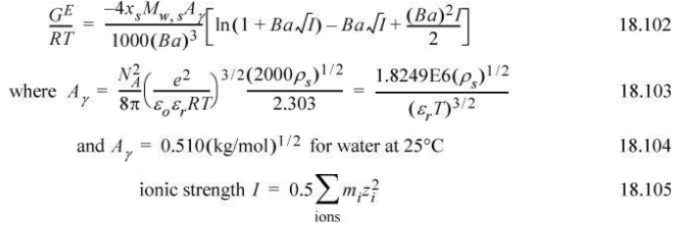
Debye-Hückel Model

Slide 61
Activity Coefficient of Water
Can be determined by measuring the osmotic pressure

Slide 62
Chlorination of Water

Slide 65
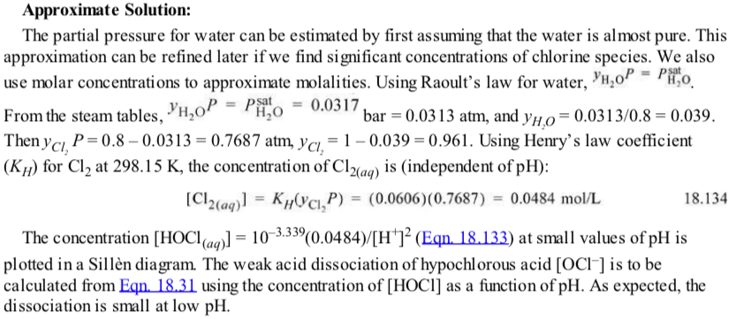
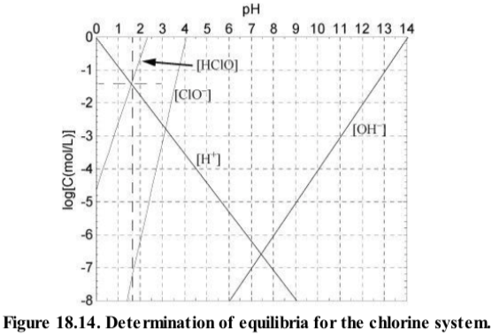
Double [H⁺] makes it about 0.3 higher

Slide 66
Double [H⁺] makes it about 0.3 higher

Slide 67
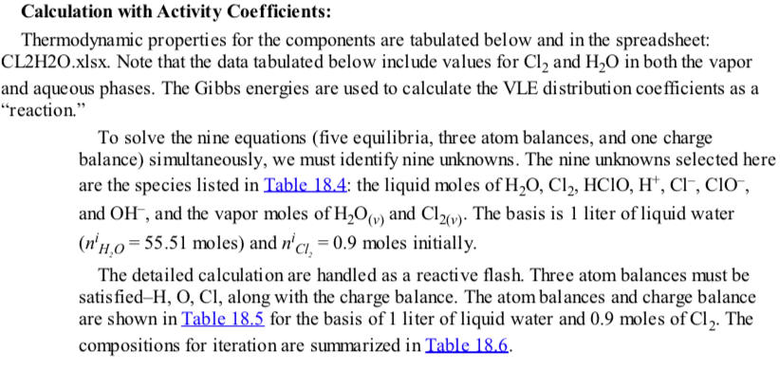
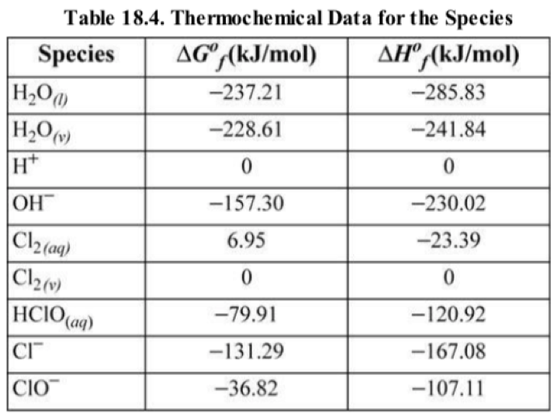
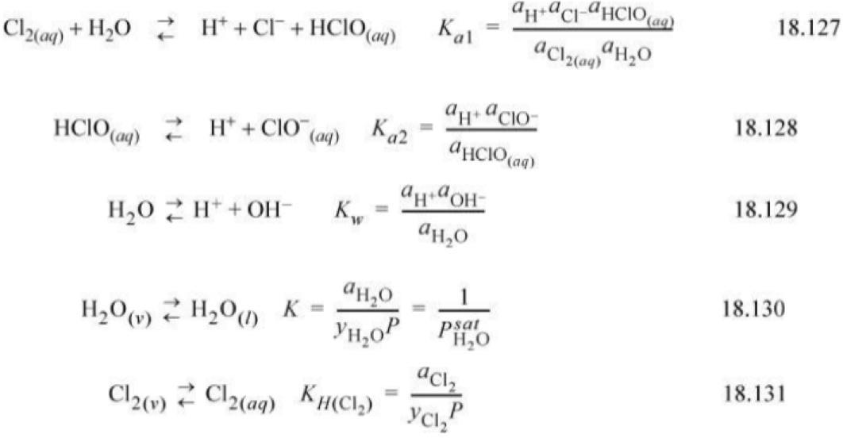
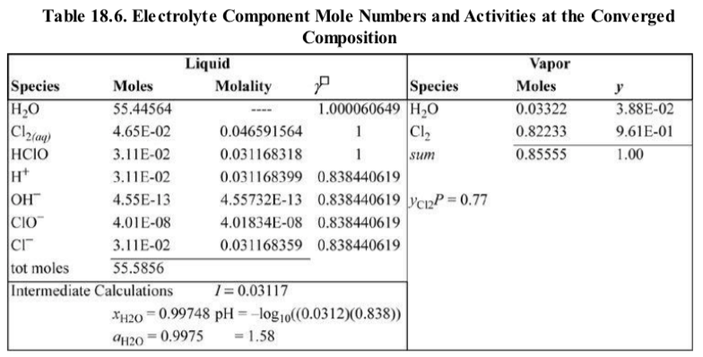

Slide 68
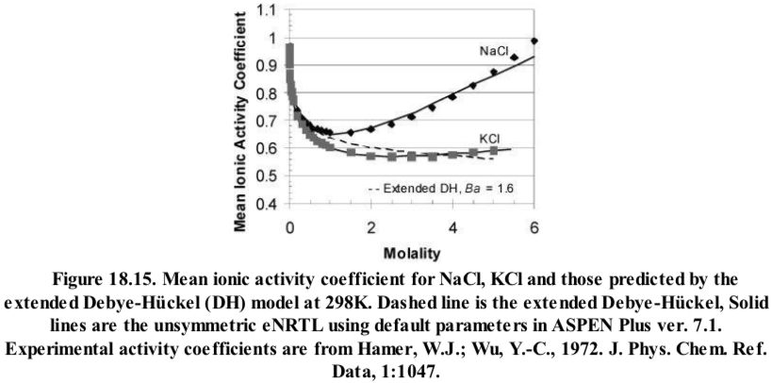
Mean (Geometric Mean) Ionic Activity Coefficients
Mean Molality:
Mean Ionic Activity Coefficient:
Stoichiometric Number

